Slide 1

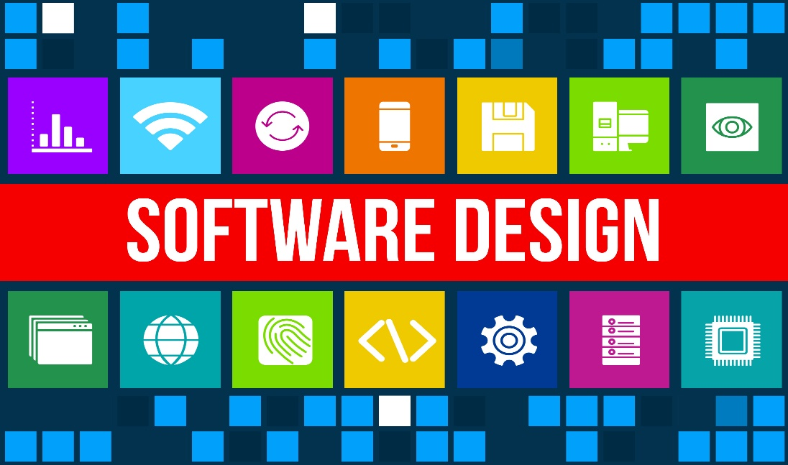
Topic: Function Oriented Design

Slide 2
Content
Software Design
Problem Partitioning
Abstraction
Strategy of Design
Bottom Up Design
Top Down Design
Hybrid Approach

Slide 3
Software Design
Software Design is more creative process than analysis as it deals with the development of the actual mechanics for a new workable system.
Design is a problem solving activity.
Designers with users has to search for a solution until a satisfactory solution has been found.
Design is a phase where designers plans “How” a software system should be produced.

Slide 4
Problem Partitioning
For solving larger problems, the basic principle is “Divide & Conquer”.
The idea behind this principle is to divide the problems into smaller & manageably pieces, so that each piece can be conquered separately.
These different pieces can not be entirely independent of each other, as they together form the system.
These different pieces have to cooperate & communicate to solve the larger problem.
The designer has to make the judgement about when to stop partitioning.

Slide 5
Abstraction
An abstraction of a component describes the external behavior of that component.
Abstraction is an indispensable(Essential) part of the design process & is essential for problem partitioning.
Abstraction is used for existing components as well as the components that are being designed.
During the design process, abstractions are used in the reverse manner than in the process of understanding a system.
There are two common abstraction mechanism for software system:
Functional abstraction
Data abstraction

Slide 6
Strategy of Design
A good system design strategy is to organize the program modules in such a way that are easy to develop and latter to change.
Structured design techniques help developers to deal with the size and complexity of programs.
Analysts create instructions for the developers about how code should be written and how pieces of code should fit together to form a program.

Slide 7
Strategy of Design
There are many strategies or techniques for performing system design. They include:
Bottom Up Design
Top Down Design
&
Hybrid Approach

Slide 8
Bottom Up Design
The bottom up design model starts with most specific and basic components.
It proceeds with composing higher level of components by using basic or lower level components.
It keeps creating higher level components until the desired system is not evolved as one single component.
With each higher level, the amount of abstraction is increased.
Bottom-up strategy is more suitable when a system needs to be created from some existing system, where the basic primitives can be used in the newer system.

Slide 9
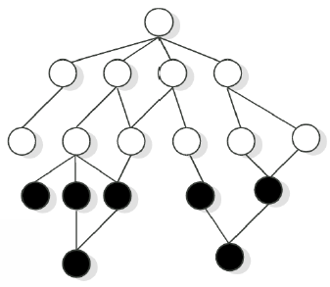
Bottom Up Design

Slide 10
Top Down Design
Top-down design takes the whole software system as one entity and then decomposes it to achieve more than one sub-system or component based on some characteristics.
Each sub-system or component is then treated as a system and decomposed further.
This process keeps on running until the lowest level of system in the top-down hierarchy is achieved.
Top-down design is more suitable when the software solution needs to be designed from scratch and specific details are unknown.

Slide 11
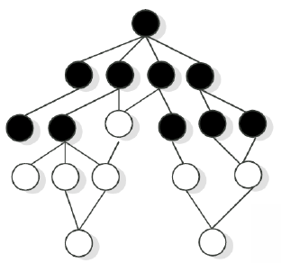
Top Down Design

Slide 12
Hybrid Approach
Pure top-down or pure bottom-up approaches are often not practical.
For a bottom-up approach to be successful, we must have a good notion of the top to which the design should be heading.
Hybrid approach is a combination of both the top – down and bottom – up design strategies. In this we can reuse the modules.

Slide 13
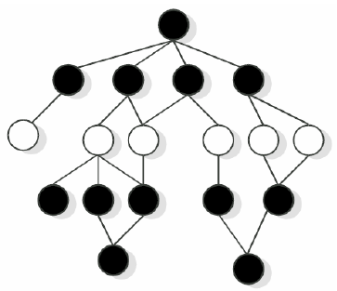
Hybrid Approach

Slide 14
References
K.K. Aggarwal and Yogesh Singh, “Software Engineering”, Third Ed., New Age International (P) Limited Publishers. (2009).
Pankaj Jalote, “An Integrated Approach to Software Engineering”, Third Ed., Narose Publishing House, (2008).
Rajib Mall, “Fundamentals of Software Engineering”, Fourth Ed., PHI Learning Private Limited, (2016).
Roger S. Pressman, “Software Engineering: A Practitioner’s Approach”, Fifth Ed., McGraw–Hill Higher Education, (2001).

Slide 15
Thank You !!!

